Slide 1
The Future of Mobility
TED GRAHAM
Head of Open Innovation
General Motors
@tedgraham

Slide 2
Notes:
I’d like you to contemplate a question over the next 20 minutes. Can you be innovative in a large company or just a start-up?
Let me tell you about my own experience. I've had a career that has played into my desire to innovate. I started my career as an entrepreneur - publishing a magazine that appeared on newsstands across this country (and I even used it twenty years ago to get into the Queen’s MBA program;

Slide 3
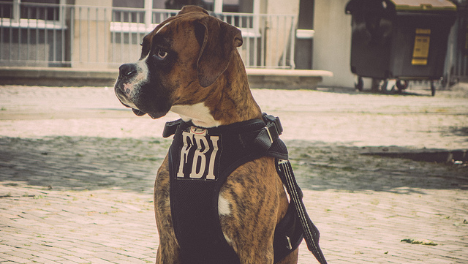
Notes:
I’ve consulted with the FBI to find an innovative way to bridge the gap between the intelligence and criminal divisions in the hope of avoiding another 9/11

Slide 4
Notes:
and I even figured out that you can strategically play Rock Paper Scissors consistently enough to earn a world ranking two years in a row. Now I'm a senior executive at a 150 year old global accounting firm. This

Slide 5
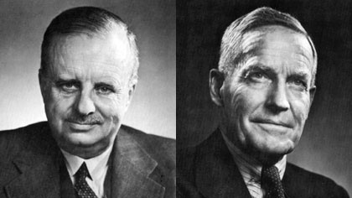
Notes:
is Currie and MacDonald. They founded an innovative Canadian start up that became Coopers & Lybrand (and now PriceWaterhouseCoopers). We have one of the most respected brands in the world and employ almost 200,000 people in 155 territories - many of them from universities just like Queens.

Slide 6
Notes:
So why do I think I can help this esteemed organization innovate by driving drunk guys around at 2 am for the past six months?

Slide 7
Notes:
Let me back up for a second to provide some context. Last year I was appointed innovation leader for PwC. It's a great title and basically means that I help turn ideas into cash. It's also a title that often gets you invited to speak at conferences that you have no real business even attending. One of my invites last year was a credit union that was looking for someone to speak about disruptive innovation at their leadership conference. I could have been like any other speaker and used some analyst reports, a case study of Kodak’s demise and I might have even surprised them with a few trends gleaned from social media commentary on their industry.

Slide 8
{ SOFTWARE EATS THE WORLD }
Notes:
People think these large, regulated industries are invincible but they struggle in the face of massive change. My own accounting industry is vulnerable to disruption with the rise of software automation. I’m talking about computing power that can do everything from personal tax returns to auditing millions of transactions to detect signs of fraud. We know that we need to think beyond what work looks like today to what creates value in the future.
In the next 10 years we will have grown but, like Uber, we’re actively looking to disrupt our industry by creating a flexible talent network to work the busiest parts of the year for PwC . This network is made up of people who have the skills and experience we need for our busiest periods but want to do other things than work full time for a company – things like see the world, create a start up, or make an impact in their community.

Slide 9
Notes:
Which why, last October, I applied to become an UberX driver. For those of you who don’t know UberX is the ride sharing service that uses a GPS enabled smart phone to efficiently match people looking for rides with drivers who use their own car to offer rides – add in automatic payments and charge 40% less for the privilege and this taxi industry nightmare has quickly reached an astronomical valuation of $40B.

Slide 10
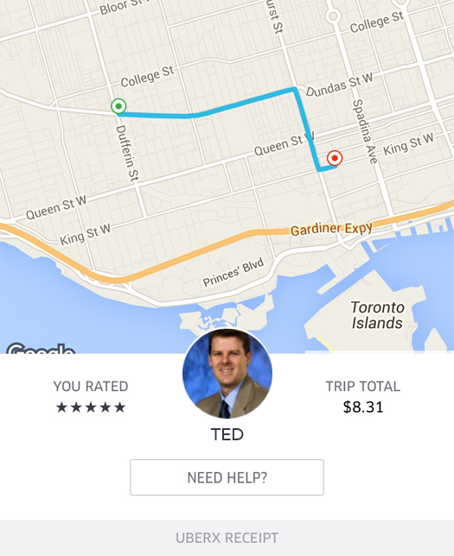
Notes:
So what did I piece together with my notebook by my side as I drove people around the city? Other than it can be very surprising when this corporate picture of me comes up on your phone – my very first passenger was a hotel executive and he said he thought it was his boss might be coming to pick him up.
Here are three lessons I learned and the actions that we’re taking as a result:

Slide 11
3
RISK & REWARD
Notes:
Balancing risk and reward in the regulated world. For years no start-up would touch regulated industries like transportation, healthcare, and education because of the burden of complying with a myriad of sometimes bizarre rules that tended to protect the large incumbent organizations.

Slide 12
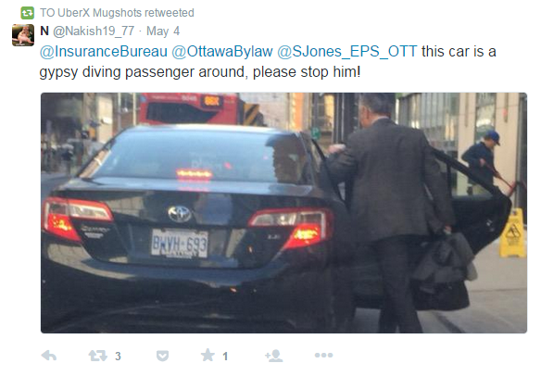
Notes:
My own experience was that I had taxi drivers (who believed they had been guaranteed a transport monopoly) shake their fist at me when they saw people getting out of my back seat. I’ve even driven under the threat of municipalities impounding my family car for purportedly offering unlicensed taxi rides. My insurance company had no idea how to navigate this new world of part time ride sharing and wanted to charge me their full time commercial driving rate which is 4-5 times that of personal insurance.

Slide 15
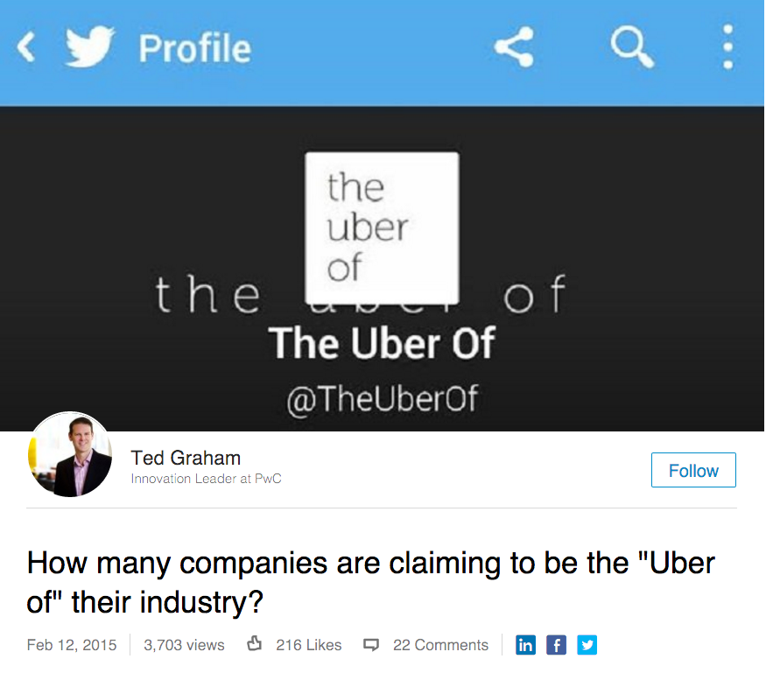

Slide 16
THE UBER OF…
PRIVATE JETS
BEAUTY
SNOW PLOWING
HOME CLEANING
BEER DELIVERY
DOG WALKING
FOOD
DELIVERY
SHIPPING

Slide 17
500
IN 2014
Notes:
A friend of mine who is another start-up veteran tells me about all of the companies on twitter that he’s been able to document

Slide 19
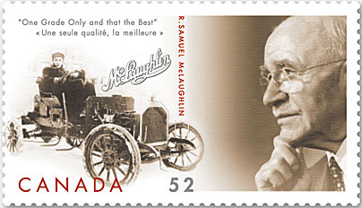
Notes:
Steve Carlisle wrote a piece in the Globe & Mail noting that we had actually reached the “most horses” on our roads in 1920 – a full 12 years after Colonel Sam motorized his horseless carriage with a Buick engine in Oshawa in 1908.
Like today, that was a very disruptive period of change.
Environmental, safety and technological factors were all at work as we started to embrace the automobile.
It was noted in New York City at the turn of the century that without a more rapid shift to internal combustion engines, horse droppings on New York roads would quickly rise to the third story level of Manhattan buildings.

Slide 20
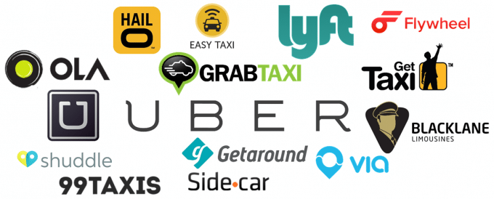
DISRUPTION EVERYWHERE
Notes:
I suspect there are very few of us here not thinking about and managing disruption.
Today – new players are rapidly moving into our space.
Companies like Google, Apple, Tesla and Uber are, I believe, just the early winds of change.
Some have called this the “Fourth Industrial Revolution” – and others the “internet of everything.”

Slide 21
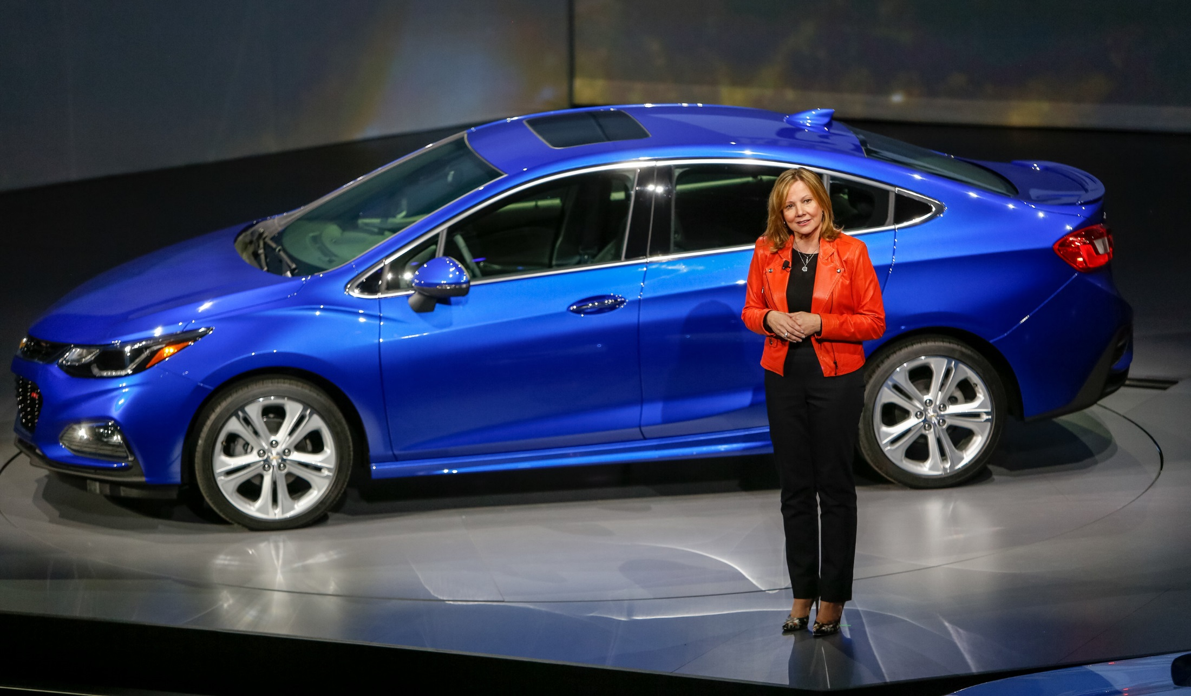
“Our goal is to disrupt ourselves, and own the customer relationship beyond the car”
- Mary Barra
Notes:
Mary Barra, our Chair and CEO has set out a clear direction for GM stating that “Our goal is to disrupt ourselves, and own the customer relationship beyond the car.”

Slide 22
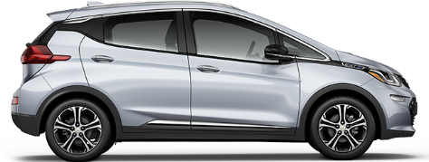
Electric
Connected
Autonomous
Shared
Notes:
At GM, we look to the future and see an auto sector that is electric, connected, and autonomous and part of the sharing economy.
These four disruptive forces are now converging and quickly redefining the future of personal mobility.
At GM, we are embracing this change as an opportunity to redefine our business models and increase the value we provide to our customers.
If we get these changes right, we will be rewarded with the loyalty of many new customers.
I also believe that if Canada can get its role right, it will be rewarded as well.
So let me expand on each of these.

Slide 23
Electric
Connected
Autonomous
Shared
Notes:
First, we see a future that will be increasingly electric.

Slide 24
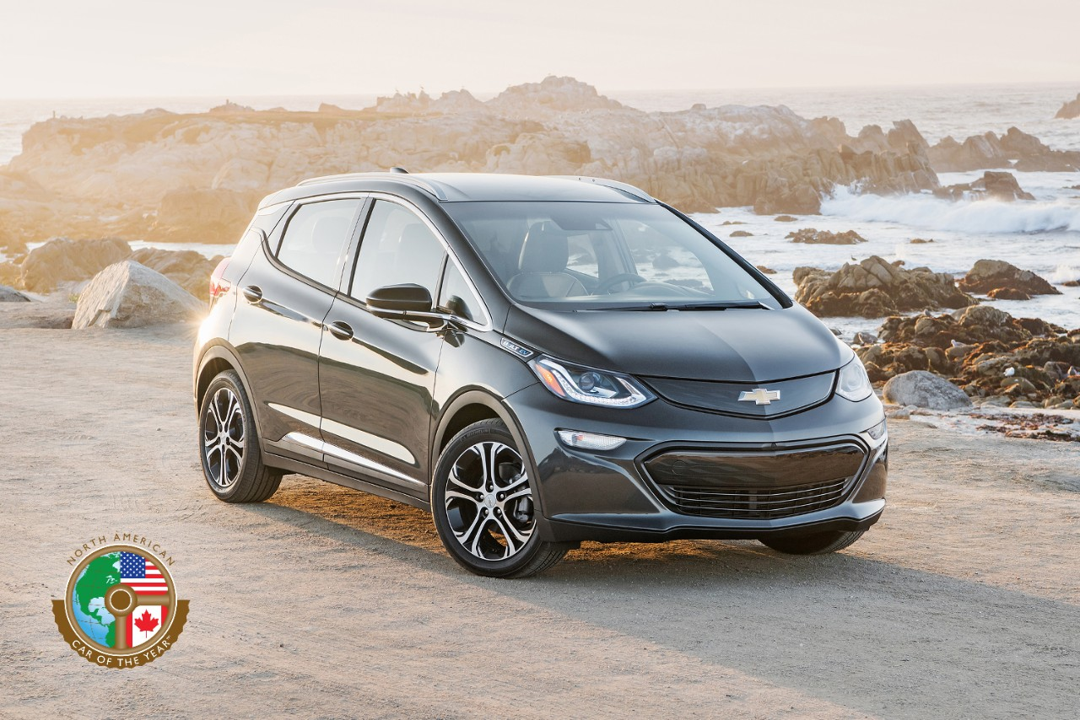
383
Electric
KILOMETRES OF RANGE
2017 CHEVROLET BOLT EV
Notes:
We are very proud that in Canada, Chevrolet has sold more EV’s in Canada than any other brand and the trend continues with Chevrolet Volt retail sales up 133 per cent in 2016.
And we are already seeing significant excitement over the Bolt EV.
Adding to its accolades - it was just named North American Car of the Year at the North American International Auto show in Detroit.
The Bolt EV is a true game changer - with a US EPA-estimated 383 km of range and a Canadian MSRP starting at $42,795, before government incentives, which can be as generous as $12,000 here in Ontario.
This puts long range all electrical vehicles into the price range of more Canadians

Slide 25
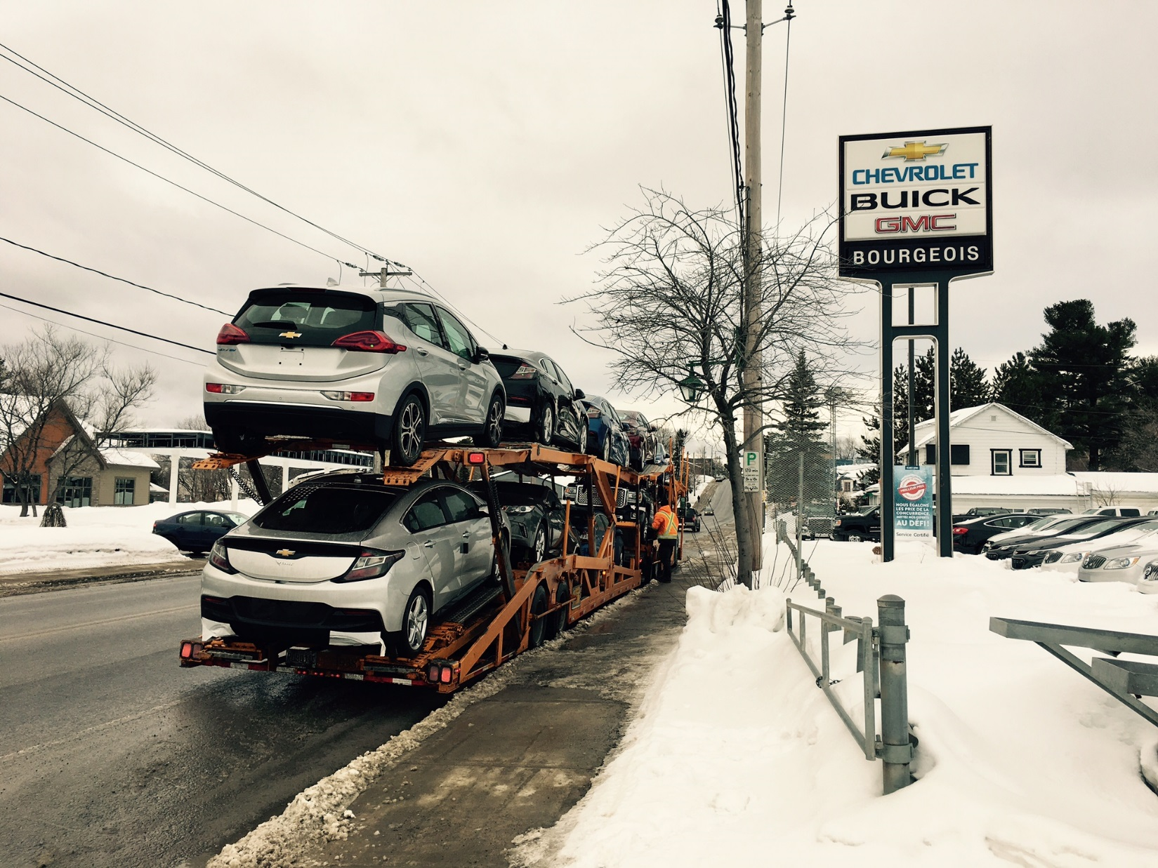
Insert photo
Electric
Notes:
In fact - our first customers have already started taking delivery and you will have an opportunity to be amongst the first in Canada to test drive it a little later today.

Slide 26
Electric
Connected
Autonomous
Shared
Notes:
The second trend - the “connected car” - is something we know a great deal about, as our cars have been connected to the wireless network through the On-Star safety system for the past 20 years and is a key focus area of our work here in Markham.

Slide 27
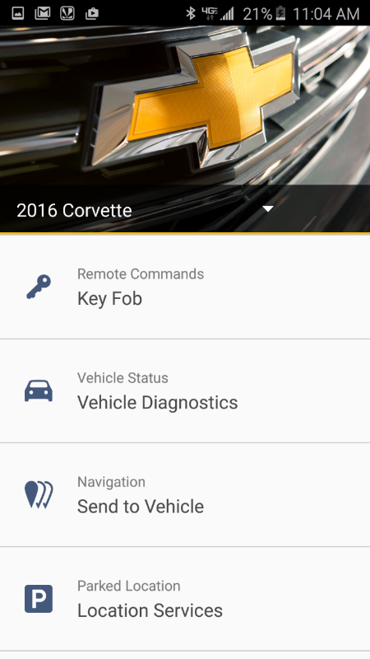
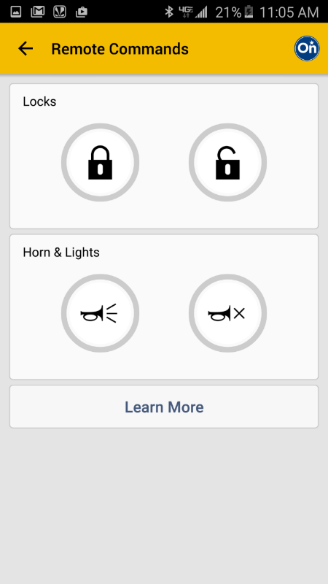
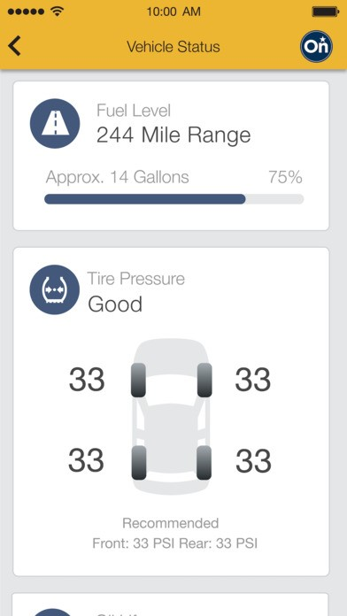
Connected
myCHEVROLET APP
Notes:
Increasingly, new car buyers expect their car to be a mobile device.
With apps like myCHEVROLET, customers leave our showrooms with an app not just a vehicle.
Users can now have their vehicle at their fingertips, with the ability to start, lock or unlock the vehicle from almost anywhere and access real time maintenance information on oil life remaining, tire pressure –and even book their next dealer visit for service.
Mobility is fast becoming a function of smart phone apps as much as the mode of transport we choose

Slide 28
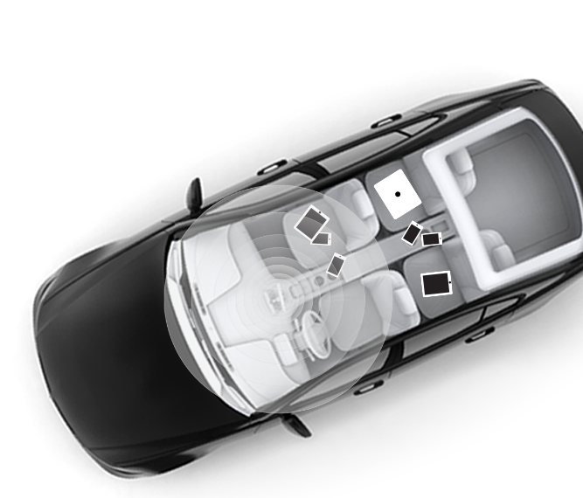
Connected
Notes:
Vehicle connectivity is also about entertainment, productivity and taking the internet with you wherever you go.
Across North America, GM now delivers available in-car Wi-Fi in all our new models enabling customers to connect up to seven devices at a time, and with more than 500,000 vehicles equipped with 4G LTE Wi-Fi, GM has the most connected vehicles on Canadian roads today!

Slide 29
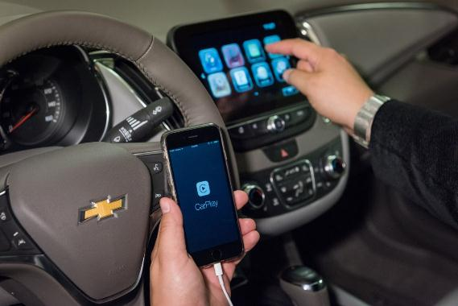
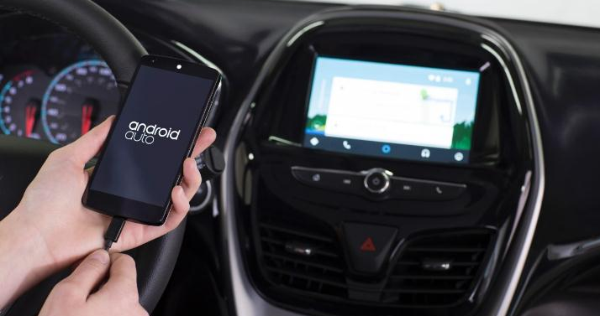
Connected
Notes:
Connectivity is also about safety which is a top priority for us here at GM.
We were the first OEM to introduce integrated mobile solutions like Apple CarPlay and Android Auto which enable safe, voice or steering wheel-activated commands like hands free calling, turn by turn directions, and voice to text so drivers can stay focused on the road and not their device.

Slide 30
Connected
Notes:
And for those of us who are parents of young drivers, there is no more important aspect of vehicle safety than protecting them.
Teenagers are three times more likely to be in fatal crashes than drivers over 20.
So, at GM we have enabled something for parents to help their teenagers learn safe driving skills. We call it Teen Driver.
It’s a safety feature initiated and operated by the parent.
It tracks:
distance driven,
maximum speed travelled,
over speed warnings,
anti-lock brake events and more.
And when activated Teen Driver automatically mutes the radio until seat belts are fastened.
If you have a teenager, you will appreciate why that works.

Slide 31
Electric
Connected
Autonomous
Shared
Notes:
The more profound trend changing our industry is the arrival of “autonomous driving.”

Slide 32
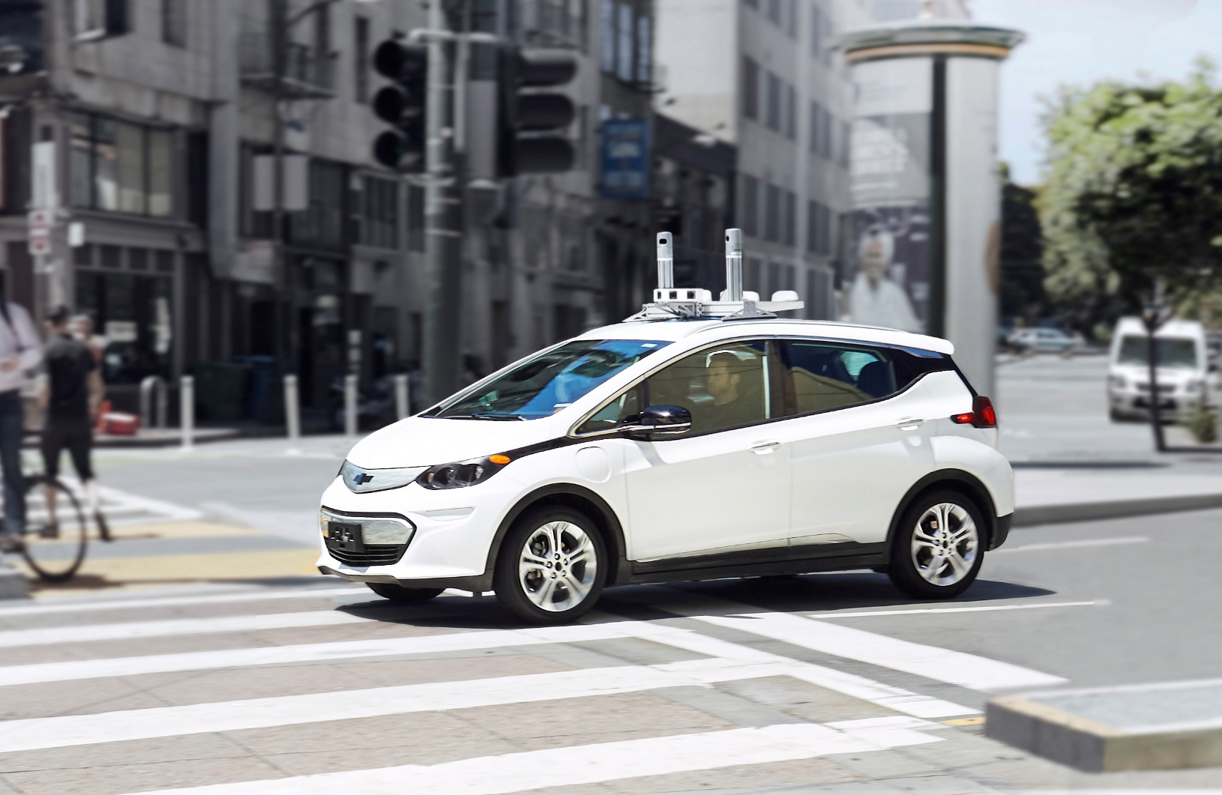
Autonomous
Notes:
Autonomous is no longer the stuff of science fiction or a far away future.
[Video plays automatically on next slide]

Slide 33
Autonomous
INVESTMENTS IN Cruise Automation & LYFT WILL Accelerate Autonomous Vehicle Development
Notes:
Just a few weeks ago, the Cruise Automation development team used an app to set their pickup and drop off location and then took an autonomous drive around San Francisco. Here you are seeing the dash cam video of the results.
Now most people are fascinated by the notion of a self-driving car. Others ask, “Why do we need that?”
The WHO estimates that globally there are more than 1.25 million road traffic deaths each year, and more than 35,000 people in the US and Canada die in car accidents mostly due to driver error.
The promise of autonomous technology is to help save lives.
PAUSE for ad-libbed narration by Steve
Today, GM is testing autonomous vehicles on roads in California, Nevada and in Michigan and we are benefiting greatly from our purchase of Cruise automation.
We recognize as well that governments are intensely interested in being part of this new technology as they look to grow their economies through innovation.
That’s understandable when you consider that some have projected that autonomous vehicles will be an $87 billion industry by 2030.

Slide 34
Electric
Connected
Autonomous
Shared
Notes:
The fourth and most immediate trend is the rise of the sharing economy and mobility as a shared service.

Slide 35
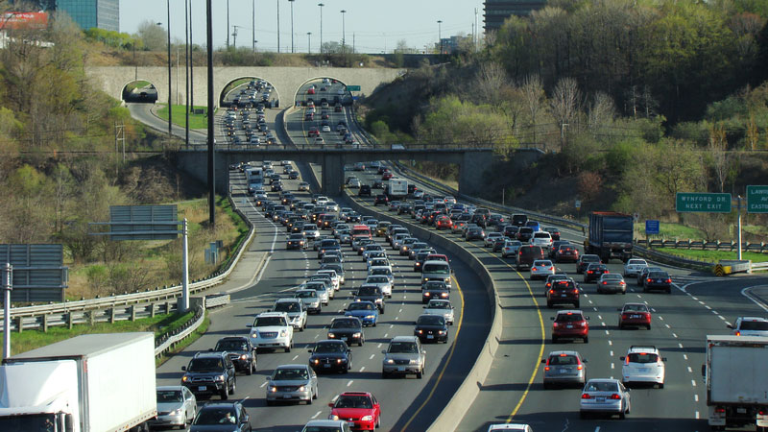
Shared
“Lots of people say they love to drive… But I haven’t met anyone yet who says they love their commute”
– Dan Ammann
President, General Motors Company
Notes:
There is no question that traffic congestion, insufficient public transit and the pain of daily commuting are all changing attitudes among consumers in profound ways.
As a leader of an auto company, it may surprise you to hear me say that we are planning for a future where our city-based customers may not even need to own a vehicle.
For our industry, manufacturing and sales and service will still be our core business, but mobility services will be the new business focus of the next 50 years.
We will need to think in terms of not just selling vehicles – but selling kilometers and gigabytes too.

Slide 36
Shared
Residential
Vehicle Sharing
City
Vehicle Sharing
Vehicles For
Ride Sharing
Notes:
Part of our answer is a new mobility services division of GM we call “MAVEN” – now operating in the US, China, Germany and Brazil and we have now begun piloting the program here in Canada.
MAVEN’s services come in several forms.
Residential Vehicle Sharing where Condo members can use the MAVEN app to reserve, unlock and start a GM vehicle from a special access to a pool of GM vehicles located right in their own building.
Through City Vehicle Sharing, MAVEN also now provides its members with access to a local network of GM vehicles placed across the city.
And through Vehicle Ride Sharing programs, we are working with a growing range of companies and drivers with convenient access to insured vehicles.
Like so many things - when it comes to the future of mobility there is an app for that…

Slide 37
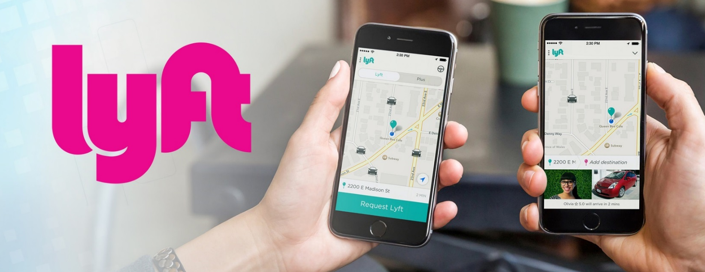
Shared
Notes:
Our MAVEN Express Drive program is now working extremely well to support Lyft drivers across the US.
But our plan with Lyft is to also create an integrated network of on-demand autonomous vehicles – including electric vehicles.
Then, last week MAVEN announced a partnership with Uber to conduct a 90-day express pilot.
Men and women who want to drive and earn money on the Uber platform will now also be able to lease GM vehicles by the week, or longer, at discounted rates with no mileage limits.
Whether working with Lyft or Uber, MAVEN gives us a great opportunity to deliver services the way our customers want to move.
It also sets up a virtuous cycle where we can manufacture and sell vehicles and support the growing ride sharing marketplace.

Slide 38
Notes:
This 150,000 square feet Campus is part of a new expanding eco-system of locations that make up the General Motors Canadian Technical Centre (or CTC ) which has a global mandate to advance Active Safety and Vehicle Dynamics, Infotainment and Connected Vehicle technologies and Autonomous Software & Controls Development.
Our eco-system includes:
The CTC – Oshawa Campus which houses 155,000 square feet of office space, labs, pre production operations, build garage, and safety test track.
Our Kapuskasing Cold Weather Development Centre, which was also part of the announced investment, and this 275 acre facility now has improved cold cells, battery labs and an expanded test track which includes autonomous testing capabilities.
With 2908@Communitech, our innovation outpost in Waterloo, we are challenging old approaches to traditional business practices, embracing an entrepreneurial mindset and looking for new business partners to help design the auto industry and the future. And the results are surpassing expectations. For example, this past fall they held a “Collision Day”, involving innovative Canadian tech firms (often AI enabled) that are now wanting to work with us - experienced entrepreneurs who didn’t have GM on their radar previously.
And as Steve mentioned we our growing our University Partnerships across Canada.

Slide 39
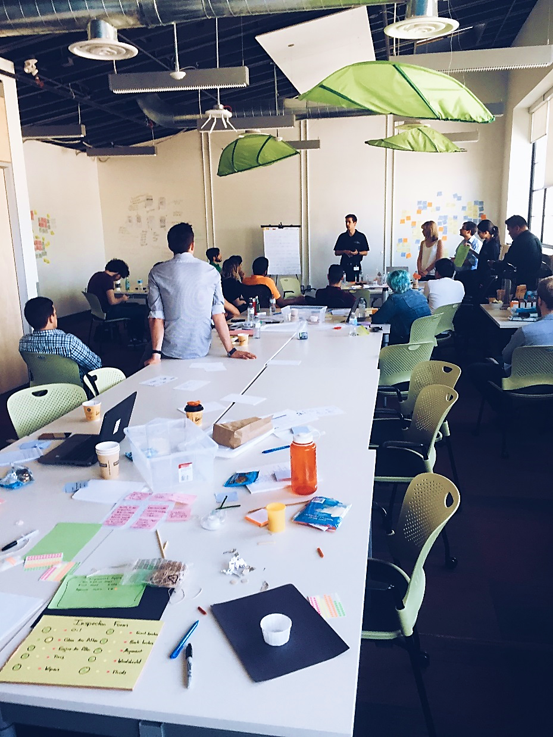
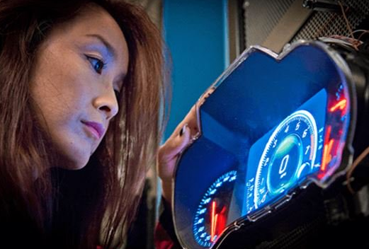
Attracting talent
Notes:
While competition is fierce we are also mindful that attracting talent is just the beginning and our teams are proactive in supporting engagement to implement the right tools and promote a culture to win.
But more than any other driver of engagement, GM enjoys one very special advantage.
We are literally reinventing mobility and smart young people find that very compelling.
Making our world safer, cleaner and better and we are exploring totally different ways of getting our customers from A to B safely, affordably and in ways that are good for the planet.
We’re all working collectively towards this cause.
And I have learned that there are few things more motivating than a truly noble cause.
Let me share the impressions of some our recent recruits and welcome Steve back up to the podium once the video rolls.
[BRIAN – sit on chair on stage]

Slide 40
AREAS OF NEED & OPPORTUNITY
Lightweight Materials
Mobile Connectivity
Data Analytics
Advanced Battery Technology
Cyber Security
Software Development
Sensors
Artificial Intelligence
Notes:
Areas of Need and Opportunity:
Lightweight Materials
Mobile Connectivity
Data Analytics
Advanced Battery Technology
Cyber Security
Software Development
Sensors
Artificial Intelligence

Slide 41
“Canada needs to now invent products to manufacture – not just manufacture products others have invented.”
Notes:
Let me leave you with this final thought.
Technology is disrupting organizations everywhere, and nowhere more than in the automotive sector.
We have everything it takes to be a leader in this transformation.
But like Colonel Sam did 100 years ago, we will also need to think differently.
We need to think about mobility as a service and we need to “invent products to manufacture –not just manufacture products others have invented.”
We will need to think about how we position our workforce to participate fully as we continue to innovate and evolve
Customers are at the heart of everything we do and that places a special responsibility on all of us to continually innovate.
So let’s do that right here in Canada.
Because if we do, this is going to be a very exciting time indeed.

Slide 42
TED GRAHAM
ted.graham@gm.com
@tedgraham
www.uberofeverything.com
www.gminnovates.ca

