Slide 1
Forum stratégique sur l'intelligence artificielle
Ramy Sedra
Associé services-conseils et leader national analytique des données
PwC Canada.

Slide 2
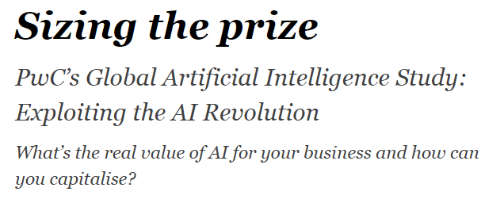
Notes:
let me share a typical client story - Moyenne entreprise du quebec etc.
full employment, new technologies, disruptive players in the market

Slide 3
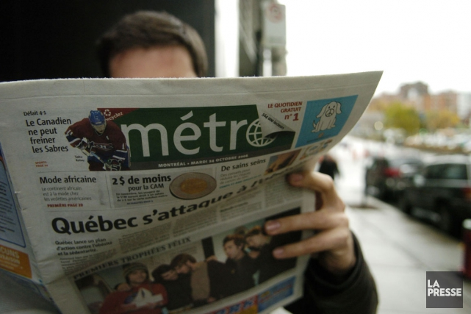
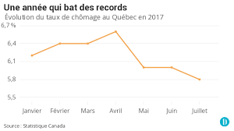
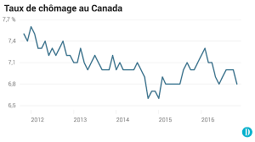
Notes:
let me share a typical client story - Moyenne entreprise du quebec etc.
full employment, new technologies, disruptive players in the market
- Conversation
News headlines about distruption and changes (tough to find labour, competition, local companies are under fire)
Headline stast drink cofffe with client and see on newspaper

Slide 4
Notes:
felt like we were operating in the dark ages

Slide 5
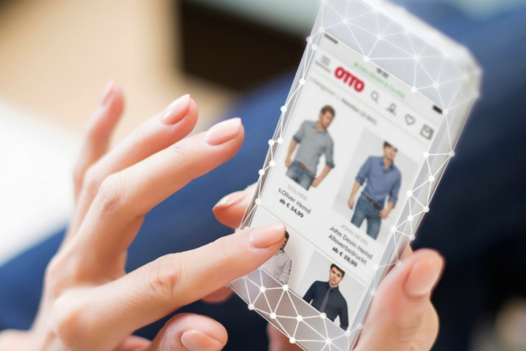
Notes:
- inspired ourselves from Global examples like Otto the Germany company that uses AI to automate SC and predict product sales to automate the inventory and logistics process

Slide 6
24 % utilisent l’intelligence artificielle (IA)
72 % des dirigeants d’entreprises croient en l’avantage concurrentiel futur de l’IA
63 % croient que l’intelligence artificielle aidera à résoudre les problèmes complexes des sociétés modernes
Notes:
- inspired ourselves from Global examples like Otto the Germany company that uses AI to automate SC and predict product sales to automate the inventory and logistics process
Logistic slide Add stats
Add slide leverage local community (Academic, researches, … no logo of org.) with network idea with PwC in middle, background of mtl (don,t need to look far)

Slide 7
MILIEU ACADÉMIQUE
SECTEUR DES TECHNOLOGIES
INDUSTRIES
Notes:
- inspired ourselves from Global examples like Otto the Germany company that uses AI to automate SC and predict product sales to automate the inventory and logistics process
Logistic slide Add stats
Add slide leverage local community (Academic, researches, … no logo of org.) with network idea with PwC in middle, background of mtl (don,t need to look far)

Slide 8
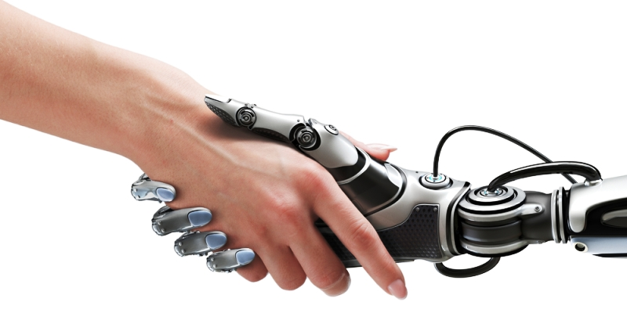
Notes:
- Today we have a partnership with mind and machine
transfer knowledge

Slide 9
Notes:
-Now we do more, are faster, are creating exciting jobs and attracting top talent
- today labour shortages, full employment, increased demand means we're thriving and winning on world stage
our machines, intelligent operations, combined with our people have transformed teh way we operate and propelled our business to the world stage
before and after, triving of the client of story, advantage compared to competitors
thriving

Slide 10
Notes:
- yet we realize that there is still so much opportunity ahead of us
we're encouraging our vendors, customers, and people to embrace this opportunity and transform themselves

Slide 11
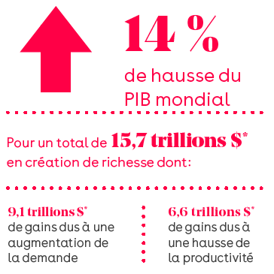
Notes:
we've realized this opportunity is for everyone, the cost of adoption is low, the time to impact is fast, and the economic impact is enormous
Innov leads to competitive and gain more talented people since there is where they want to be
Stats GDP growth taken advantage the increase in growth
JS- include GDP 2030 stats
Best of all the community to do it is right here
- Many in this room
- OUR mission: practitioners, academics, industry and business experts is to collaborate to transfer the knowledge from our leading thinkers and academics to businesses
we grow as a community of AI user and benefactor

Slide 12
91 000 travailleurs en TIC
1ère métropole canadienne en R et D universitaire
9000 étudiants en IA et mégadonnées
Vague d’investissements records en IA et mégadonnées
Notes:
Best of all the community to do it is right here
- Many in this room
- OUR mission: practitioners, academics, industry and business experts is to collaborate to transfer the knowledge from our leading thinkers and academics to businesses
we grow as a community of AI user and benefactor

Slide 13
$700M
78 COMPAGNIES
28 ASSOCIATIONS
12 INSTITUTIONS ACADÉMIQUES
ENGAGEMENTS
Notes:
(l’addition des actions - impact / connectivity in our business community) This will drive your business and OUR economy to the next level. CEST ENSEMBLE
- PwC believes in this vision - Nous sommes au centre de ce réseau Why we want to be at the heart of the AI community and why collaborator to the AI Supercluster initiative
- Why in just over a month we rallied over 7600M in commitments from + Over 80 Canadian companies, 26 business associations, and 12 Canadian academic institutions like Louis Roy and Optel Group, Couche Tard, CGI and have the support of leading academic partners like IVADO, U of Waterloo
Stats: retails, opportunity to everyone, cost of enabling is low

Slide 14
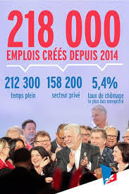
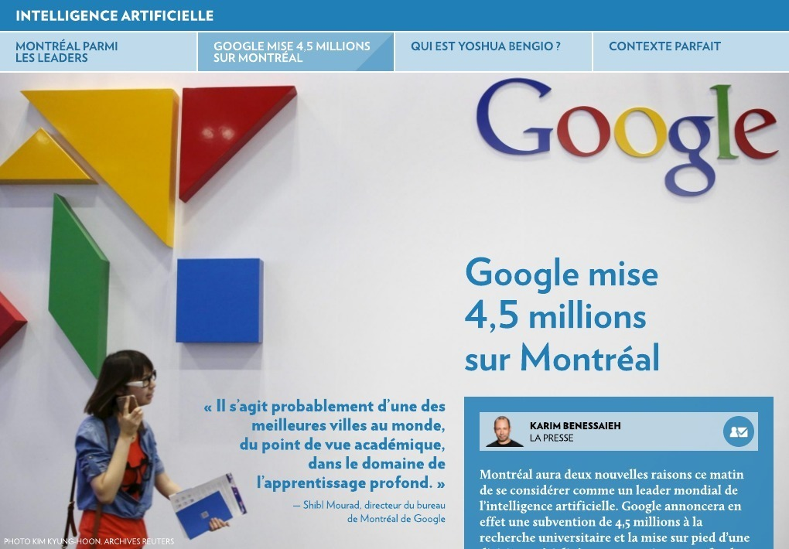
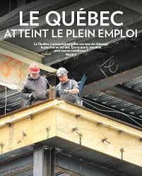
Notes:
let me share a typical client story - Moyenne entreprise du quebec etc.
full employment, new technologies, disruptive players in the market
- Conversation
News headlines about distruption and changes (tough to find labour, competition, local companies are under fire)
Headline stast drink cofffe with client and see on newspaper

Slide 15
Notes:
We all believe that AI is one of the most significant opportunities of this generation
- We believe that Montreal is the hub to lead this transformation for Quebec, for Canada, and on the world stage.
- Thank you
Other slide AI logo put in center, pwc believe in this mission ( PwC au Coeur de cette vision)
Stats: numbers around the logos
Industry partners
Enablers
Academics inst.
Financial commitment

